Slide 1
TOURISM MANAGEMENT SYSTEM
GRAPHIC ERA DEMMED UNIVERSITY, DEHRADUN
BACHELOR OF TECHNOLOGY
IN
COMPUTER SCIENCE & ENGINEERING
SUBMITTED BY:PRASHASTI CHAUHAN
UNIVERSITY ROLL NO.: 2019005
MENTOR NAME:Mr. PRAMOD MEHRA

Slide 2
TOURISM MANAGEMENT SYSTEM
INTRODUCTION:-
The main objective of the Travels and Tourism Management System is to manage the details of Customer, Hotel Booking, Cancellation and Tourism places. It manages all the information about Users, Hotel, Packages etc. The project is totally built at administrative end and thus only the administrator is guaranteed the access to the backend database. The purpose of this project is to build an application program to reduce the manual work for managing Tourists, Booking, Places etc. This application will help in accessing the information related to the travel to the particular destination with great ease. The users can track the information related to their tours with great ease through this application. The travel agency information can also be obtained through this application.
Through this system, the propose system is highly automated and makes the travelling activities much easier and flexible. The user can get the very right information at the very right time. This system will include all the necessary fields which are required during online reservation time. This system will be easy to use and can be used by any person. The basic idea behind this project is to save data in a central database which can be accessed by any authorize person to get information and saves time and burden which are being faced by their customers.
Administrator can access and modify the information stored in the database of this system, this includes adding and updating of details, and it will give accurate information and simplifies manual work and also it minimizes the documentation related work. Provides up to date information. Finally booking confirmation notification will be send to the users.
Tourists can register by providing personal details, make new reservation and book only one hotel and package and can make cancellation.

Slide 3
TOURISM MANAGEMENT SYSTEM
OBJECTIVE:
The objective of the project is to develop a system that automates the processes and activities of a travel and tourism agency.
The purpose is to design a system using which one can perform all operations related to traveling and sight-seeing.
Existing System
In the present system a customer has to approach various agencies to find details of places and to book tickets.
This often requires a lot of time and effort.
A customer may not get the desired information from these offices and often the customer may be misguided.
It is tedious for a customer to plan a particular journey and have it executed properly.
Proposed System
The proposed system is a web based application and maintains a centralized repository of all related information.
The system allows one to easily access the relevant information and make necessary travel arrangements.
Users can decide about places they want to visit and make bookings online for travel and accommodation.

Slide 4
TOURISM MANAGEMENT SYSTEM
PROBLEM STATEMENT:-
Problem Scenario:
In olden days people wishes to go for tours like temples, historical monuments, refreshment places one has to go to railway station or bus station and book tickets by standing in long queues which wastes people time and energy. People face problems like residence, food etc. they may face problem with language in case of long tours. Online tourism will reduce all this hectic tasks.
Proposed Solution:
Online tourism concept is introduced to reduce wastage of energy and time of people. People can search different places and historical spots. One can know about the tourism places in and around a particular place or city. The user can just search places and view packages provided. If he is satisfied with the package he can give his details and pay the amount and book the tour. The user can also search his or her tour status and can cancel reservation. The travel staff will book bus and hotel tickets. Once user pays amount, the system maintains the tour information and user information of particular user. User details are protected by the system by validating user accounts.1) Scarching package2) Book tour3) View status4) Cancel reservation

Slide 5
TOURISM MANAGEMENT SYSTEM
METHODOLOGY:-
The Tour and Travel Management System is a web based application. The main purpose of "Tours and Travels Management System" is to provide a convenient and easy way for a customer to book hotels, flight, train and bus for tour purposes. To run this System, Software and Hardware Requirements are necessary. Requirements which are needed are given below briefly.
Hardware Requirements:
Processor At least 2.0 GHZ
RAM-At least 2GB
Software Requirements:
Operating System Windows.
Runtime Environment Net Framework 4.5
Frond End PHP, HTML, CSS, JavaScript, Ajax.
Back End MySQL
Editor Tools Atom, Notepad++
Other Graphics Tools Adobe Photoshop
Web Browser-Google Chrome, Firefox, or any compatible update browser.
Project Develop Languages:
There are two kinds of languages have used in "Tour Management System". One is Programming Language and other is Database Language. Front End, I have used PHP. JavaScript, HTML, CSS & Back End, I have used MySQL Database Language in my "Tour Management System"
Programming Language & Markup Language: PHP, JavaScript, HTML
Color Script Language: CSS

Slide 6
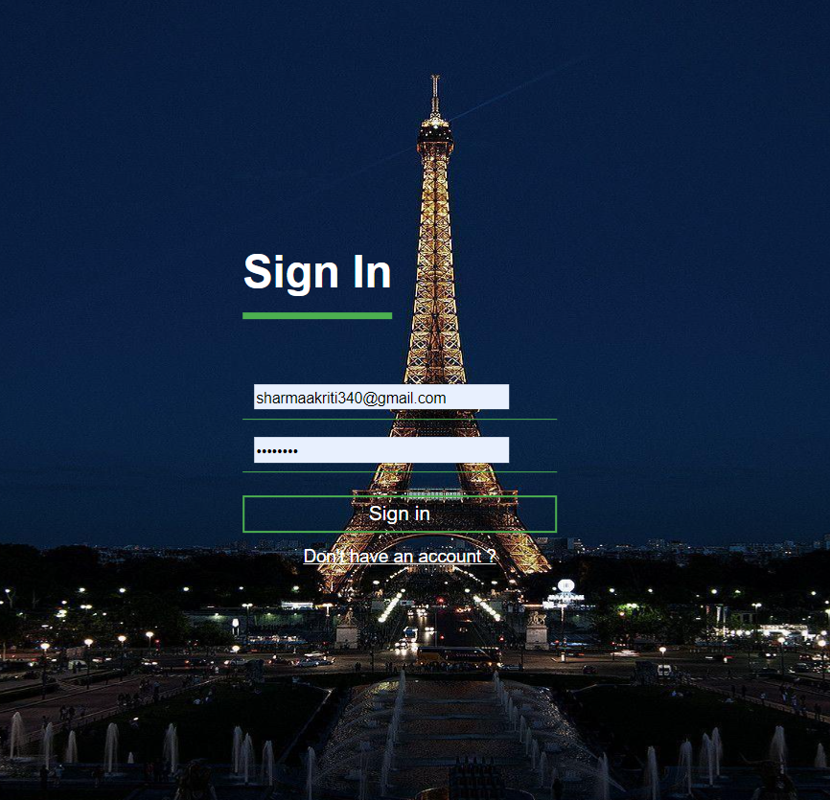
TOURISM MANAGEMENT SYSTEM
RESULT AND DISCUSSION:-
login page:

Slide 7
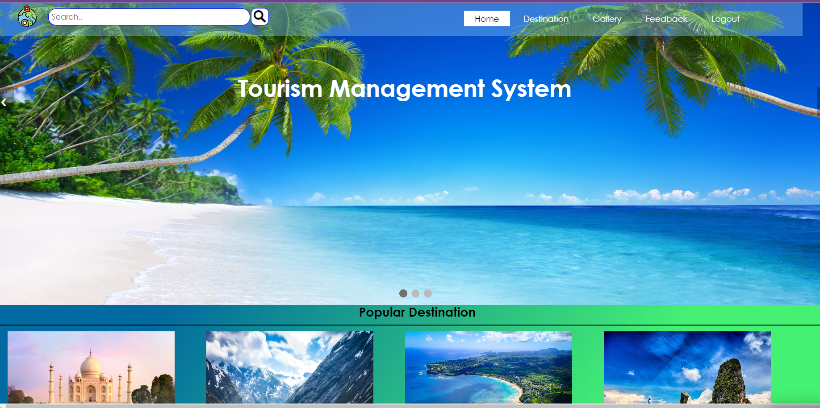
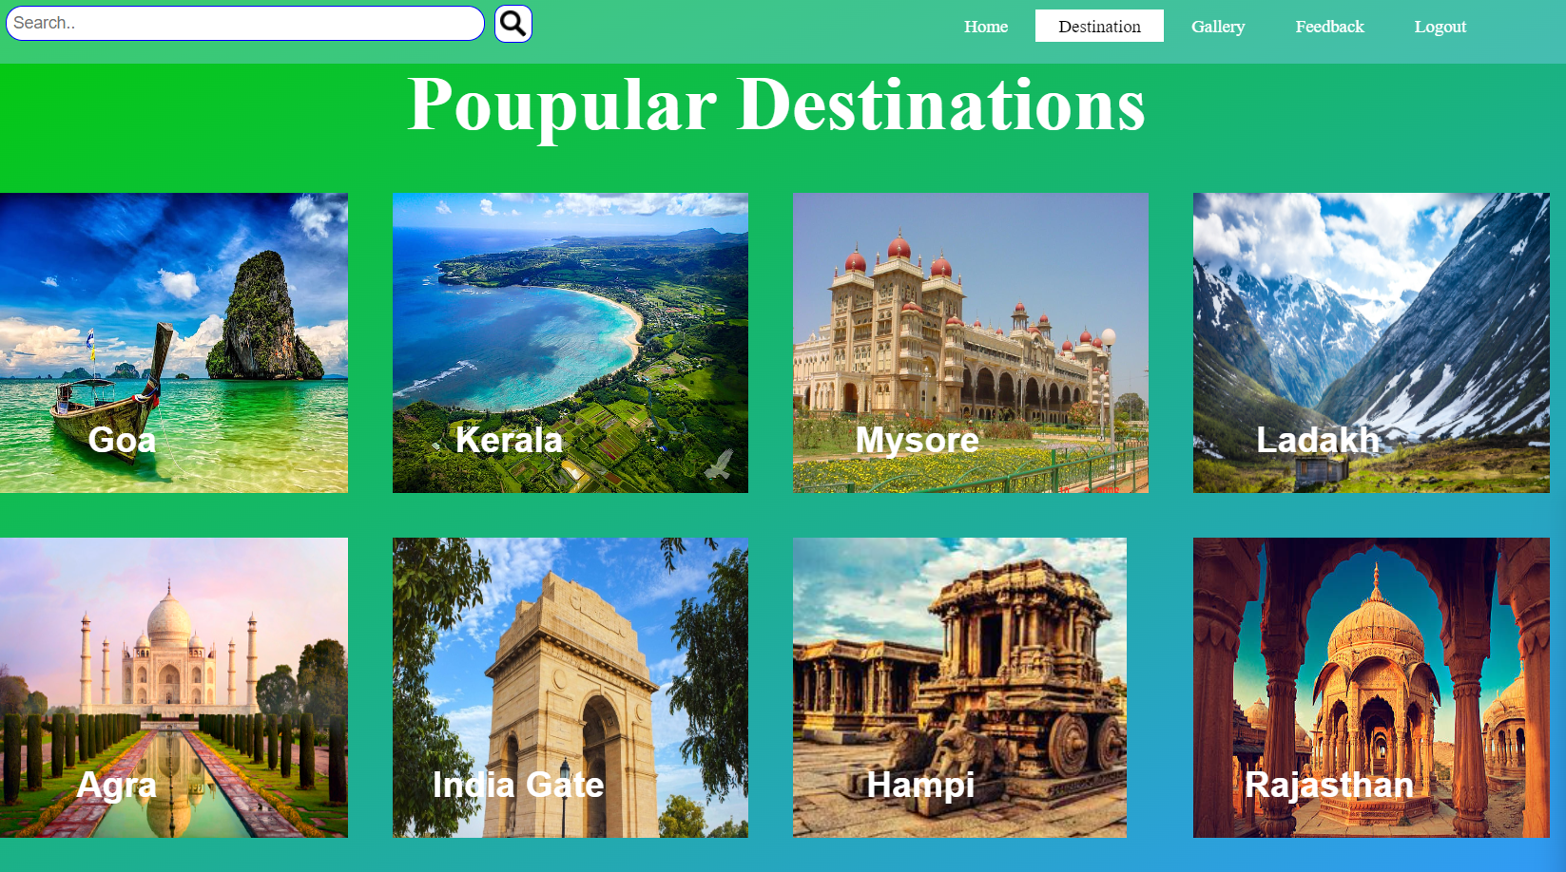
TOURISM MANAGEMENT SYSTEM
RESULT AND DISCUSSION:-
Front page of the system: Popular destination:

Slide 8
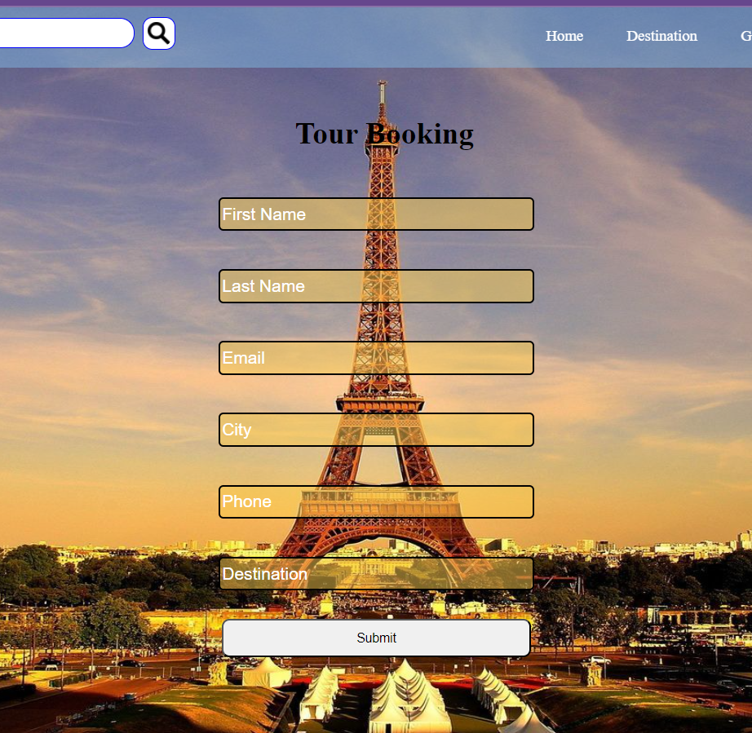
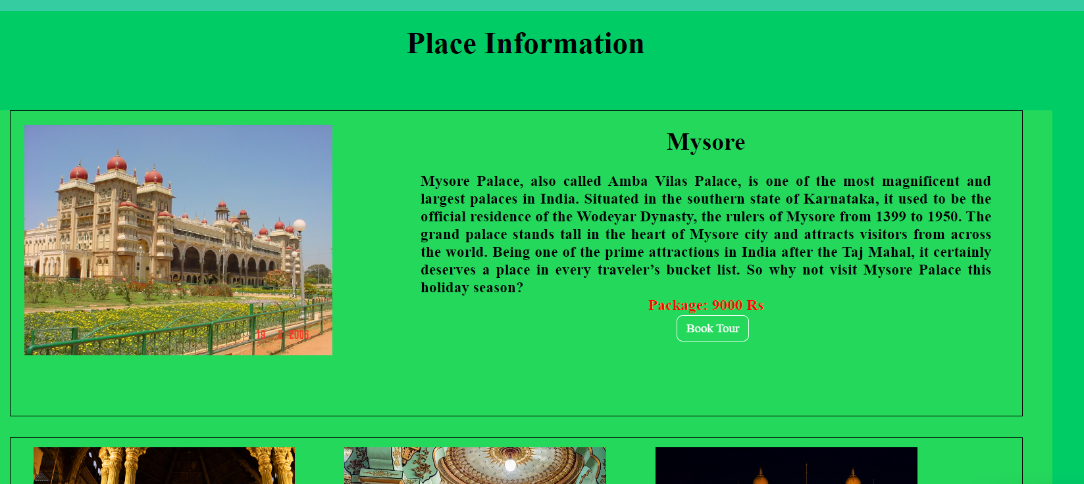
TOURISM MANAGEMENT SYSTEM
RESULT AND DISCUSSION:-
Booking of tour: Tour booking Form:

Slide 9
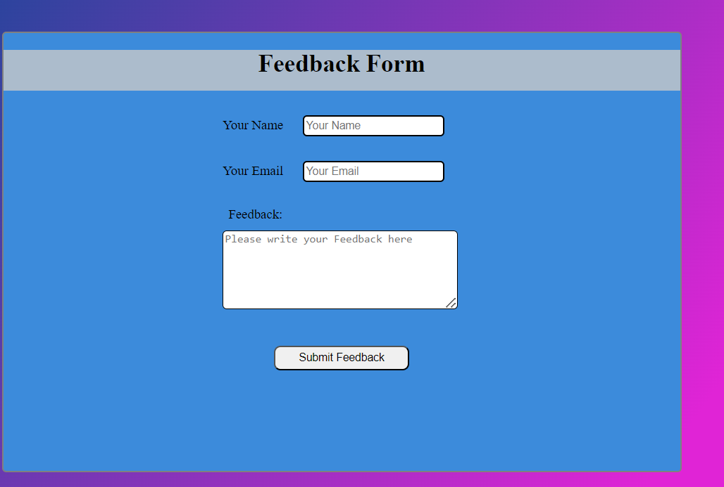
Tourism management system
Feedback form:

Slide 10
TOURISM MANAGEMENT SYSTEM
CONCLUSIN :-
CONCLUSION:
Travelers continue to seek authentic experiences. The tools they use to research and book these experiences are constantly changing due to innovations in technology. Destinations are also challenged by limited financial resources and strong competition for tourist dollars from other iconic and even lesser known locations. The personalization of travel suggests that independent travel will have a stronger presence than group travel, however, we must always consider the type of traveler. The travel services sector is being forced to innovate at a startling rate.
In the past, face to face consultations with a travel agent was paramount for booking both leisure and business travel. Technology and global circumstances, such as pandemics, financial collapses, and terrorism, have put pressure on tourism and travel services. With the development of OTAs and emerging and disruptive technologies, the travel services landscape is constantly changing.

Slide 11
TOURISM MANAGEMENT SYSTEM
REFERENCES:
https://www.scribd.com/document/434577908/Toursim-Management-System-Tms-Project-Report
https://www.studocu.com/in/document/dit-university/software-engineering/project-report-of-travel-and-tourism-management-system/54299421
https://www.studocu.com/in/document/dit-university/software-engineering/travel-and-tourism-management-system-srs/38131242?origin=course-suggestion-1
https://www.slideshare.net/slideshow/tour-management-system/108701001

Slide 12
TOURISM MANAGEMET SYSTEM
THANK YOU

